Slide 1



California’s New Indoor Heat Illness Prevention Regulation
PRESENTED BY
Robert C. Rodriguez (Sacramento)
Karen F. Tynan (Sacramento)
July 24, 2024

Slide 2


Speakers
Robert Rodriguez
Sacramento
robert.rodriguez@ogletree.com
Karen Tynan
Sacramento
karen.tynan@ogletree.com

Slide 3
  You will understand the current status of the proposed draft Indoor Heat regulation;
  You can implement the required processes and plans in your workplace;
  You will understand the areas of risks for citations and how to avoid or minimize those risks;
  You can evaluate your indoor heat risks and continue to implement your heat illness prevention plan; and
  You will make an action plan based on your “takeaways.”

Slide 4
AGENDA
Today - Current Enforcement
New Regulation Section 3396
Review Indoor Heat Standard
  Important Definitions
  Exceptions
  Water, Cool-Down Areas, Control Measures, Etc.
Best Practices
2024-2025 Outlook

Slide 5
A little “heat” data for perspective ….

Slide 6
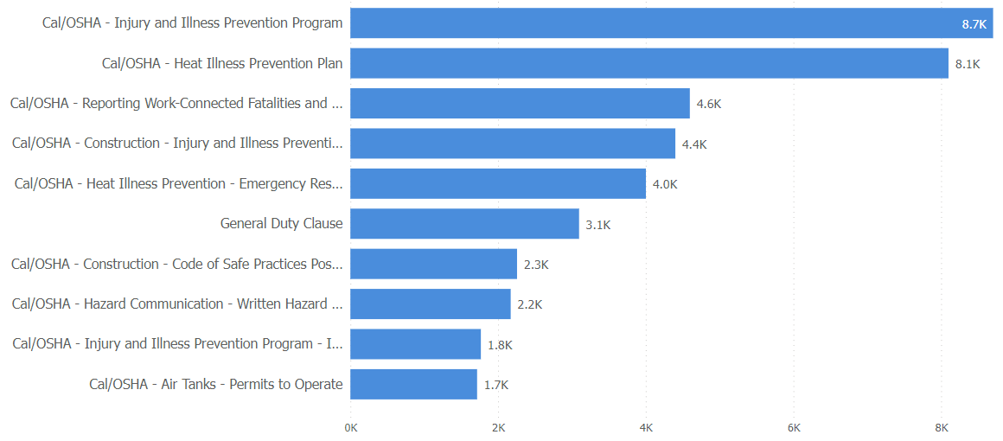
Trends 2012-2022 - California
Top 10 Standards by No. Citations

Slide 7
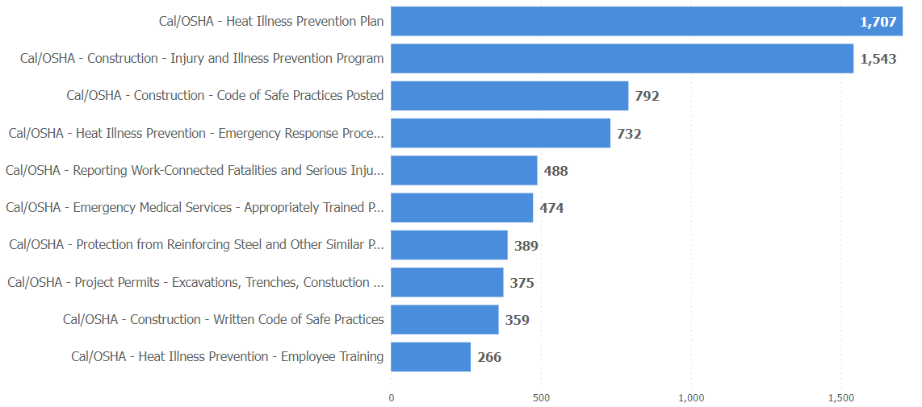
Trends 2012-2022 - California
Construction Industries Top Standards

Slide 8
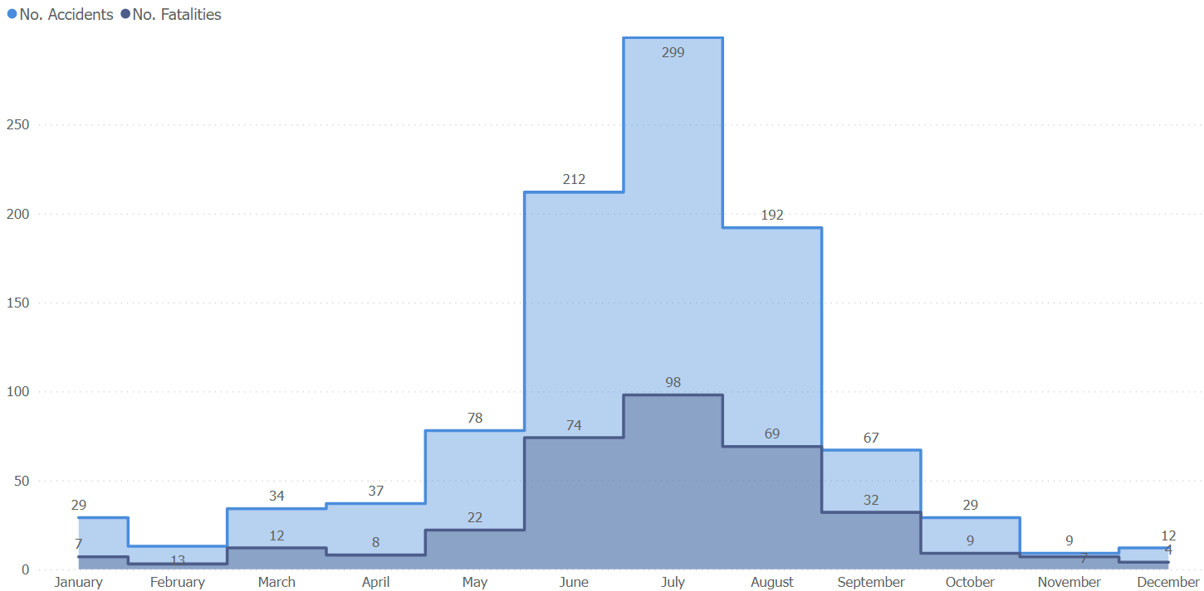
OSHA Data - Accidents
By July for “heat” Events

Slide 9

Indoor Heat Illness Standard
CCR Title 8, Section 3396

Slide 10
Timeline for California Employers
  June 20, 2024 → Standards Board voted unanimously to adopt the latest draft version of indoor heat regulation
  Board Chair Joseph M. Alioto Jr. offered a respectful request to the Office of Administrative Law (OAL) that the agency “process the regulation in a timely manner considering that summer is upon us.”
  How long will OAL take?
  Could be as early as August 1, 2024

Slide 11
Cal/OSHA and IIPP
  Cal/OSHA can enforce for indoor heat under the IIPP regulation
  3203(a)(4) Failure to identify or evaluate a work hazard (indoor heat)
  3203(a)(6) Failure to correct unsafe condition
  3203(a)(7) Failure to provide training and instruction for the hazard of indoor heat

Slide 12

Indoor Heat Illness Prevention

Slide 13
Written Heat Illness Prevention Plan
  Must have written plan
  Can be integrated into the Injury and Illness Prevention Program (IIPP)
  Maintain the Heat Illness Prevention Plan on site or close to the site, so that it can be made available to employees and representatives of Cal/OSHA upon request
  The written plan should be in English and the language understood by the majority of employees

Slide 14

California Indoor Heat Illness
Elements
  Access to water
  Access to cool-down areas
  Temperature Checks
  Acclimatization
  Assessment and Control Measures
  Employee/supervisor training
  Written procedures
Practice Pointer – The plan must be provided to an inspector upon request.

Slide 15

California Indoor Heat Illness (cont’d)
Section 3396 – Heat Illness Prevention in Indoor Places of Employment
When is regulation triggered?
  Indoor places of employment
    If it is not outdoor, it is indoor
  Temperature triggered – 82 degrees/87 degrees (when employees present)

Slide 16
California Indoor Heat Illness (cont’d)
Exceptions:
  Teleworking from a location of the employee's choice, which is not under the control of the employer
  Incidental heat exposures where an employee is exposed to temperatures at or above 82 degrees Fahrenheit and below 95 degrees Fahrenheit for less than 15 minutes in any 60 minute period
Exceptions to Exceptions:
  Vehicles without effective and functioning air conditioning
  Shipping or intermodal containers during loading, unloading, or related work

Slide 17
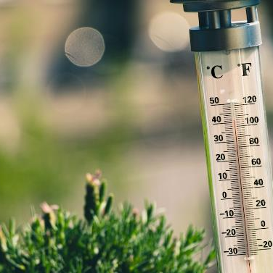
Monitor the Weather
  Indoor places of employment impacted by weather
  Track predicted weather for worksite
  What procedures should employers have?
  What sources can be used?

Slide 18
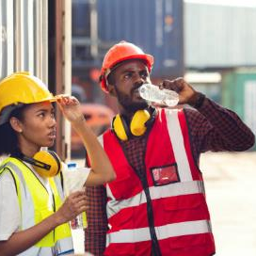
Access to Water
  Potable drinking water at no cost
  Sufficient quantities of pure and cool potable drinking water
  Enough to provide at least one quart per employee per hour for entire shift
  Must be fit to drink
  Prevent contamination
  Effective replenishment procedures
  Practice Pointer – This is the most frequently cited Heat Illness violation in CA.

Slide 19
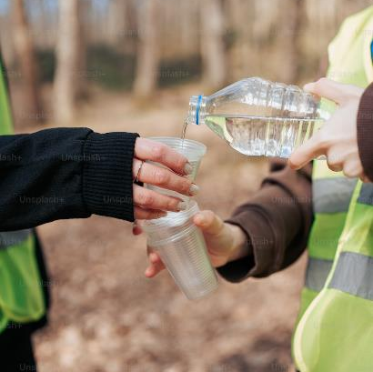
Access to Water
  Location → As close as practicable to work areas and cool-down areas
  Readily accessible
  Encourage frequent drinking of water
  Do not wait until thirsty

Slide 20
SCENARIO #1
Frankie and Tony work together on 2nd shift at a large distribution center. Frankie tells Tony that he is feeling hot and wants to go take a break in his truck with the AC running so he can listen to music and try to meditate a little to cool down. Frankie says that he will check in with the supervisor on the way to the truck.
  What should Tony do?
  What are the processes or procedures that the employer should be adhering to?

Slide 21
Indoor Cool-Down Areas
  At least one cool-down area
  Maintained at less than 82 degrees (unless infeasible)
    Open to the air or ventilation / cooling
  Blocked from direct sunlight / shielded from high radiant heat sources
  Large enough to accommodate employees in a normal posture
  As close as practicable to work area

Slide 22
Preventative Cool-Down Rest
  Must allow and encourage employees to take preventative cool-down rest, no less than 5 minutes plus time to access area cool-down area
  Monitored and asked if they are experiencing symptoms of heat illness
  Encouraged to remain in the cool-down area
  Not be ordered back to work until any signs or symptoms of heat illness have abated
  Access to cool-down areas “shall be permitted at all times”
  Labor Code 226.7(a) →Wage and hour issues
Practice Pointer – Update your break policy. Incorporate these breaks in policy.

Slide 23

Assessment and Control Measures
Triggered at 87 degrees (actual temperature or heat index)
Two Choices:
  Assume workplace is over 87 and applicable
  Take very specific measurements → Where employees work and at times during the shift when employee exposure to heat is expected to be greatest, including having employees or union involved in taking the temperature

Slide 24
Assessment and Control Measures (Indoor)
If 87 degrees or higher, must take additional steps in a phased approach to get the temperature below 87 degrees
  “Feasible” Engineering Controls → Administrative Controls → Heat PPE
  When assessing whether something is “feasible,” monetary cost is not a factor that is considered → Variance

Slide 25
Assessment and Control Measures
“Engineering controls” to reduce and maintain both the temperature and heat index to below 87 degrees.
  An “Engineering Control” is defined as a “method of control or a device that removes or reduces hazardous conditions or creates a barrier between the employee and the hazard.” The proposed regulation provides the following non-exhaustive list of examples:
    Isolation of hot processes, isolation of employees from sources of heat, air conditioning, cooling fans, cooling mist fans, evaporative coolers (also called swamp coolers), natural ventilation where the outdoor temperature or heat index is lower than the indoor temperature or heat index, local exhaust ventilation, shielding from a radiant heat source, and insulation of hot surfaces.

Slide 26
Assessment and Control Measures
“Administrative Controls” to minimize the risk or heat illness.
  An “Administrative Control” is a method to limit exposure to a hazard by adjustment of work procedures, practices, or schedules. The proposed regulation provides the following non-exhaustive list of examples:
    Acclimatizing employees, rotating employees, scheduling work earlier or later in the day, using work/rest schedules, reducing work intensity or speed, reducing work hours, changing required work clothing, and using relief workers.

Slide 27
Assessment and Control Measures
“Personal Heat-Protective Equipment” to minimize the risk of heat illness. “Personal Heat-Protective Equipment” is equipment worn to protect the user against heat illness.
  The proposed regulation provides the following non-exhaustive list of examples:
    Water-cooled garments, air-cooled garments, cooling vests, wetted over-garments, heat-reflective clothing, and supplied-air personal cooling systems.

Slide 28
Emergency Response Procedures
Effective communication – be able to contact supervisor
Respond to signs and symptoms of possible heat illness
  Supervisor to take immediate action
  If serious heat illness indicated, implement emergency response procedures
  Employees exhibiting or reporting signs or symptoms of heat illness should be monitored and not left alone – onsite first aid or appropriate emergency medical services should be offered
  Contact emergency medical services and ensure that clear and precise directions to the site can be provided
  Directions to worksite

Slide 29
Acclimatization
What is acclimatization?
  All employees shall be closely observed by a supervisor or designee during a heat wave
  Heat wave = any day in which the predicted high temperature for the day will be at least 80 degrees Fahrenheit and at least 10 degrees Fahrenheit higher than the average high daily temperature in the preceding five days
  An employee who has been newly assigned to a high heat area should be closely observed by a supervisor or designee for the first 14 days of the employee’s employment
Best practices?

Slide 30

Acclimatization
Best practices?
  Be attentive to newer employees or ones that have been away
  Consider lessening the intensity and/or shift length of the newly hired employees’ work during a two or more week break-in period
  Modify the work schedules during hot Julys

Slide 31
Training
All employees and supervisors before beginning work that could reasonably lead to heat illness. Required topics -
  Environmental and personal risk factors for heat illness, as well as the added burden of heat load on the body
  Employer’s indoor heat illness prevention plan procedures
  The importance of frequent consumption of small quantities of water, up to
  4 cups per hour, when the work environment is hot and employees are likely to be sweating more than usual in the performance of their duties
  Acclimatization
  Types of heat illness and importance of reporting heat illness for themselves or co-workers
  Response procedures and EMS procedures and procedures for communicating to emergency responders

Slide 32
Additional Supervisor Training
  Same topics as employees
  The procedures the supervisor is to follow to implement the required procedures
  The procedures the supervisor is to follow when an employee exhibits signs or reports symptoms consistent with possible heat illness, including emergency response procedures
  How to monitor weather reports and how to respond to hot weather advisories

Slide 33
Issue Spotting – Radiant Heat
  “High radiant heat area” means a work area where the globe temperature is at least five degrees Fahrenheit greater than the temperature. “Temperature” means the dry bulb temperature in degrees Fahrenheit obtainable by using a thermometer freely exposed to the air without considering humidity or radiant heat, to measure the temperature in the immediate area where employees are located.
  “High radiant heat source” means any object, surface, or other source of radiant heat that, if not shielded, would raise the globe temperature of the cool-down area five degrees Fahrenheit or greater than the dry bulb temperature of the cool-down area.

Slide 34
Issue Spotting – Radiant Heat
  “Shielding” means a physical barrier between radiant heat sources and employees that reduces the transmission of radiant heat.
  This is an example of an “engineering control.”
Discussion Point – What are some examples of radiant heat?
  Grills, fryers, food preparation, manufacturing processes like glass, foundries, laundry processes, etc.

Slide 35
Issue Spotting – Radiant Heat
Regulation Requirements –
  When employees work in high radiant heat areas, engineering controls shall be used to reduce the temperature and heat index to below 82 degrees F.
UNLESS
  The engineering controls are infeasible. If infeasible, then use engineering controls to reduce the temperature or heat index to lowest feasible level; use engineering controls to otherwise minimize the risk of heat illness. Then, use administrative controls.

Slide 36
SCENARIO #2
Tony and Chris work together in a manufacturing environment where tools are created. In the creation process, materials are heated to 400 degrees Fahrenheit, and the manufacturing machines radiate heat. Tony and Chris work within 20 feet of the machines, and no matter what, it’s always over 90 degrees in the area of the machine.
  How do you address the heat hazard?

Slide 37
ARE YOU READY?

Slide 38
What Will OSHA Do During a Heat-Related Inspection?

Slide 39
Determine whether the employer has a heat illness and injury program, including whether:
  The employer has a written program;
  Employees have been trained;
  The employer monitors temperature and worker exertion;
  Unlimited cool water is easily accessible to workers;
  The employer provides required cool-down breaks;
  Acclimatization process.

Slide 40
Top Heat Illness CSHO Inspector Interview Questions
  Where is your written indoor heat illness plan?
  Do you know what acclimatization is? Have you been acclimatized?
  Where is the water? Is it cold?
  Where do you go to cool off or rest?
  What are the symptoms of heat illness?
  If you feel heat illness symptoms, what do you do?
  Who performs and how is the temperature and heat monitored at this worksite?

Slide 41
Q & A

Slide 42
California Indoor Heat Illness Prevention
Model California Indoor Heat Illness Prevention Plan Template
  To help employers meet these new standards, we have prepared a model California Heat Illness Prevention in Indoor Places of Employment Compliance / Template Package. The templates include:
    Model California Indoor Heat Illness Prevention Plan
    PowerPoint training deck
    Hazard assessment form
    Notice to employees
    Overview for stakeholders
  Our comprehensive template package is available to clients for $1,000.00.
For more information or to purchase the package, please reach out to Robert or Karen

Slide 43
Resources And Events
Ogletree Blogs
Ogletree Webinar - Federal OSHA’s New Heat Injury and Illness Prevention Proposed Rule July 17, 2024
Ogletree Events – ALWAYS SELL OUT!!! REGISTER EARLY!!!
  California Workplace Safety Conference, Two Sessions
    Oakland October 1, 2024
    Orange County October 3, 2024
  National Workplace Safety Symposium December 4-6, 2024
    New Orleans Marriott Warehouse Arts District

Slide 44
Thank you!
Robert C. Rodriguez
Co-Chair, Workplace Violence Prevention Practice Group
Ogletree, Deakins, Nash, Smoak & Stewart, P.C.
400 Capitol Mall, Suite 2800 | Sacramento, CA 95814
robert.rodriguez@ogletree.com | Phone: 916.337.6958
Karen F. Tynan
Co-Chair, Workplace Violence Prevention Practice Group
Chair West Coast OSHA Practice
Ogletree, Deakins, Nash, Smoak & Stewart, P.C.
400 Capitol Mall, Suite 2800 | Sacramento, CA 95814
karen.tynan@ogletree.com | Phone: 707.508.8476

