Slide 1
  MARCH 2024
SB553
California’s New Workplace Violence Prevention Law
Presented by:
Karen F. Tynan (Sacramento)
Robert C. Rodriguez (Sacramento)

Slide 2
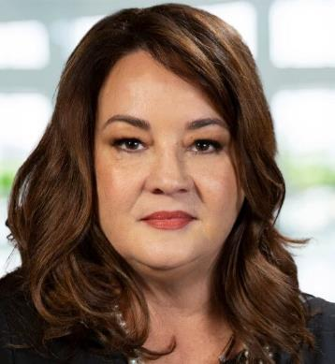
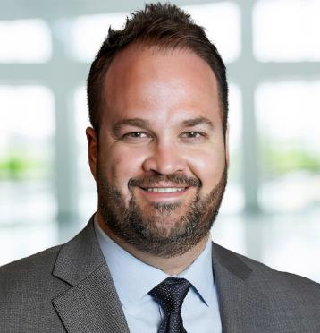
Speakers
Karen F. Tynan
Sacramento
karen.tynan@ogletree.com
Robert C. Rodriguez
Sacramento
robert.rodriguez@ogletree.com

Slide 3

Agenda
Current Enforcement
Senate Bill (SB) 553
  Requirements
  Compliance
Scenarios
FAQs
Best Practices
Questions and Answers
Note: This is for Non-Healthcare Settings

Slide 4

CURRENT ENFORCEMENT – Workplace Violence
Can enforce under the IIPP Standard
Respond to complaints and serious injuries or fatalities
  Don’t forget if an employee is transported from your worksite, first responders likely report the incident to Cal/OSHA District Office
Definite change from prior years
Hot button issue for Cal/OSHA
  Women and vulnerable populations
  High-profile cases and publicity

Slide 5
SB 553: Workplace
Violence Prevention Plan

Slide 6

Labor Code 6401.9
SB 553 adds Section 6401.9 to the California Labor Code
Applies to “all employers, employees, places of employment, and employer-provided housing” with few exceptions
Current law and regulations require that employers establish, implement, and maintain an effective IIPP
Employers must now have a workplace violence prevention plan as part of the IIPP

Slide 7
Labor Code 6401.9
Applies to “all employers, employees, places of employment, and employer-provided housing” with few exceptions
  Health care settings
  Facilities operated by the Department of Corrections and Rehabilitation
  Law enforcement
  Telework – not under employer’s control
  Places of employment with less than 10 employees not accessible to public and comply with IIPP regulation (still have to analyze hazards)
  BUT → Cal/OSHA can issue an order to require exempt employers or places to have a workplace violence prevention plan

Slide 8
Important Definitions
Engineering controls – “an aspect of the built space or a device that removes a hazard from the workplace or creates a barrier between the worker and the hazard”
Threat of violence – “any verbal or written statement, including, but not limited to, texts, electronic messages, social media messages, or other online posts, or any behavioral or physical conduct, that conveys an intent, or that is reasonably perceived to convey an intent, to cause physical harm or to place someone in fear of physical harm, and that serves no legitimate purpose”

Slide 9
Important Definitions
Work practice controls – “procedures and rules which are used to effectively reduce workplace violence hazards”
Workplace violence types
  Type 1 violence: workplace violence by person who has no legitimate business at the worksite
  Type 2 violence: workplace violence by customers, clients, patients, students, inmates, or visitors
  Type 3 violence: workplace violence against an employee by a present or former employee
  Type 4 violence: workplace violence by person who does not work there, but has or is known to have had a personal relationship with an employee

Slide 10
Workplace Violence Prevention Plan
Establish, implement, and maintain an effective workplace violence prevention plan
Plan must be in writing
Accessible to all employees, authorized employee representatives, and Cal/OSHA
Stand alone or part of IIPP

Slide 11
Workplace Violence Prevention Plan
“[S]pecific to the hazards and corrective measures for each work area and operation”
What does this mean?
Different areas may present different risks
  Example: office area with public access vs. warehouse location
  Example: winery tasting room vs. vineyard

Slide 12
Written Workplace Violence Prevention Plan
Names and job titles of those responsible for implementation
Employee involvement in developing the plan
  Identifying, evaluating, and correcting violence hazards
  Designing and implementing training
  Reporting workplace violence incidents
Potential issues → What if employees or union demand certain procedures?

Slide 13

FAQ #1
Can our written plan have some parts that are “front facing” to employees, but have some confidential information such as active shooter response?

Slide 14
Scenario 1 – What Would You Do?
Alec and Emma work together on the first shift. Emma comes to HR at the end of her shift and explains, “Today, Alec said he has a gun in his locker at work.” Emma explains that previously she has overheard Alec and Paul arguing including Alec threatening to “kick Paul’s teeth out.” She’s concerned, unsure if this is a threat or violence, but wants to keep the information confidential. She says, “I just want you to know in case something happens.”
What would you do?
Is this workplace violence?

Slide 15

Multi-Employer Worksites
Coordination with other employers
Multi-employer worksites
Must communicate with other employers
Who will be responsible?
Examples of multi-employer worksites include construction sites, temp or agency employees assigned to a location, etc.

Slide 16
Procedures
(Non-Active Situation)
Communicate with employees – reporting and investigations
Identify and evaluate workplace violence hazards
  Periodic inspections
  When first established
  After each incident
  Any previously unrecognized hazards
Correct hazards in a timely manner

Slide 17
Procedures
(Active Situation)
Respond to actual or potential workplace violence
  Alert employees of the presence, location, and nature of workplace violence emergencies
  Evacuation or sheltering plans that are appropriate and feasible for the worksite
  How to obtain help from staff assigned to respond to workplace violence emergencies (if any), security personnel (if any), and law enforcement

Slide 18

FAQ #2
We use contingent workers from a staffing agency, can we rely on the staffing agency to train the workers on a workplace violence plan?

Slide 19

Employer Investigations
Employee concerns
Workplace violence incidents
Tied to violent incident logs
Inform employees of results
Written investigation report – can create complex issues
Privilege issues – can we protect the investigation with attorney work product?

Slide 20

FAQ #3
What parts of our investigation, logs, determinations, employee statements, and related materials can be privileged or confidential?

Slide 21
Violent Incident Logs
Employer must prepare a very detailed log of all workplace violence incidents → not a high-level summary
Requirements similar to those in a police report
Log entries based on investigation findings
Privacy protection for witnesses
Date, time, and location of the incident
Types of violence (see definitions)
Detailed description

Slide 22
Violent Incident Logs
Who committed violence (i.e., employee, customer, family/friend, stranger, spouse, etc.)
Where the incident occurred (i.e., workplace, parking lot, etc.)
Specifics about type of incident (i.e., physical/verbal, weapons, threats, sexual assault, animal attack)
Date, time, and location of the incident
Was law enforcement contacted?
What actions did employer take?

Slide 23
Scenario 2 – What Would You Do?
Bland Construction is a framing company working at the Wheeler Joint Venture, a huge project with at least eight sub-contractors on any given day. Romano Electrical is also at the site with 10 employees, including Frankie, a journeyman lineman. At a morning superintendent meeting, Romano’s superintendent offers that Frankie and an unknown Bland employee got into a fistfight yesterday by the Taco Truck. Frankie was sent to the ER and got 18 stitches and was treated for a broken wrist.
What should Wheeler Joint Venture do?
What should Bland Construction do?
What should Romano Electrical do?

Slide 24
Training
All employees
Each employee must understand the plan, procedures, and their roles
Training materials – content and vocabulary to the educational level, literacy, and language of employees must be used
When first established
Annually
Previous unrecognized hazard

Slide 25
Training Topics
The employer’s plan, how to obtain a copy of the employer’s plan at no cost, and how to participate in development and implementation of the employer’s plan.
The definitions and requirements of this section.
How to report workplace violence incidents or concerns to the employer or law enforcement without fear of reprisal.
Workplace violence hazards specific to the employees’ jobs, the corrective measures the employer has implemented, how to seek assistance to prevent or respond to violence, and strategies to avoid physical harm.
The violent incident log required by subdivision (d) and how to obtain copies of records required by paragraphs (1) to (3), inclusive, of subdivision (f).
An opportunity for interactive questions and answers with a person knowledgeable about the employer’s plan.

Slide 26
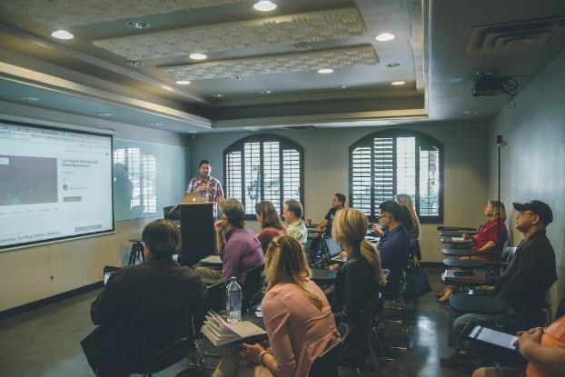
FAQ #4
What the heck does interactive mean? Can’t I use a chatbot to deliver training?

Slide 27

Record Keeping
Inspection records → 5 years!
Violent incident log → 5 years!
Workplace violence investigations → 5 years!
Training records → 1 year
All records must be made available to Cal/OSHA upon request
Employees or union can obtain certain records – 15 days

Slide 28
FAQ #5
As part of the law’s requirements, do I have to have active shooter drills?
Won’t they just scare employees?
Isn’t that just for schools?

Slide 29

2024 – What Is Next?
Cal/OSHA resources towards workplace violence
Enforcement by inspections
Document requests will include a request for your workplace violence prevention plan
Inspection employee interviews may include questions about your program
Press releases by Cal/OSHA

Slide 30
Best Practices – Start Now
Work with stakeholders and employees
Adopt a written plan
Customize for all work areas
Provide training at onboarding and periodically
Document your plan and your work towards compliance
Determine recordkeeping and investigation processes and procedures
Conduct drills and revise plan as needed
Take reports of violence seriously

Slide 31

Questions and Answers

Slide 32
RESOURCES
Ogletree
  https://ogletree.com/insights-resources/blog-posts/
  https://ogletree.com/insights-resources/webinars/
  https://ogletree.com/insights-resources/podcasts/
Cal/OSHA Information and Publications
  https://www.dir.ca.gov/dosh/Workplace-Violence.html
  https://www.dir.ca.gov/dosh/dosh_publications/WPV-General-Industry-for-employers-fs.pdf
  https://www.dir.ca.gov/dosh/dosh_publications/Model-WPV-Plan-General-Industry.docx

Slide 33
EVENTS
Ogletree Events
  California Workplace Safety Conference October 2024
    Two Sessions: Oakland and Orange County
  National Workplace Safety Symposium December 4-6, 2024
    New Orleans Marriott Warehouse Arts District
    https://ogletree.com/app/uploads/events/seminars/national-seminars/2024-Workplace-Safety-Symposium.pdf

Slide 34

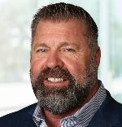








West Coast Occupational Safety Practice
Karen F. Tynan – Chair West Coast OSHA Practice
Shareholder | Sacramento
karen.tynan@ogletree.com
(707) 508-8476
Kevin D. Bland
Shareholder | Orange County
kevin.bland@ogletree.com
(949) 813-1120
Robert C. Rodriguez
Shareholder | Sacramento
robert.rodriguez@ogletree.com
(916) 840-3292
Jennifer Yanni
Of Counsel | Orange County
jennifer.yanni@ogletree.com
(714) 800-7914
Elizabeth Rhodes
Of Counsel | Sacramento
elizabeth.rhodes@ogletree.com
(916) 840-3281
Eugene F. McMenamin
Of Counsel | Orange County
eugene.mcmenamin@ogletree.com
(714) 800-2308
Kathryn P. Fletcher
Of Counsel | Seattle
kathryn.fletcher@ogletree.com
(206) 876-5317
Nicole A. Naleway
Associate | Orange County
nicole.naleway@ogletree.com
(714) 800-7902

Slide 35

Stay Up to Date on LinkedIn

Slide 36

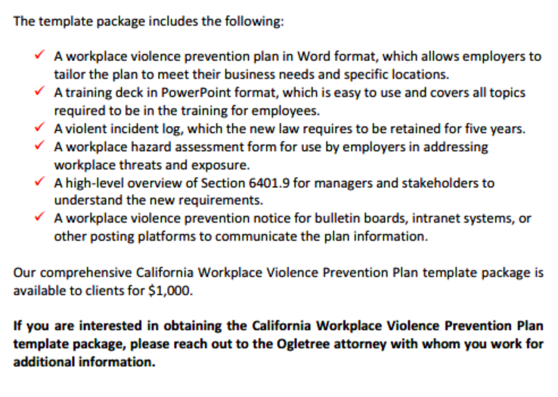

Slide 37

Thank you!
Karen F. Tynan
500 Capitol Mall, Suite 2500 | Sacramento, CA 95814
karen.tynan@ogletree.com | Phone: 707.508.8476
Robert C. Rodriguez
500 Capitol Mall, Suite 2500 | Sacramento, CA 95814
robert.rodriguez@ogletree.com | Phone: 916.840.3292

